Slide 1
Software Quality Engineering
Lecture 2-Chapter 1
Overview and Basics
Alina Arshad
alina.arshad@nu.edu.pk

Slide 2
Cost of Quality
Broken down into two classifications and four categories:
Conformance
Prevention costs
Appraisal costs
Non conformance
Internal failure costs
External failure costs

Slide 3
Cost of Quality - Explanation
The cost of quality includes all costs incurred in the pursuit of quality or in performing quality related activities.
It is also a powerful tool for identifying waste whether is of effort, or time or resources.
COQ = Cost of conformance + Cost of non-conformance

Slide 4
Formula
Cost of Quality = Cost of Control + Cost of Failure of Control
where
Cost of Control = Prevention Cost + Appraisal Cost
and
Cost of Failure of Control = Internal Failure Cost + External
Failure Cost

Slide 5
Cost of Quality - Explanation
CoSQ generally focuses on three major components:
Cost of monitoring defects
Cost of correcting defects
Cost of reducing defects

Slide 6
Cost of Quality
CoSQ
Conformance
Prevention
Appraisal
Non- Conformance
Internal Failure
External Failure

Slide 7
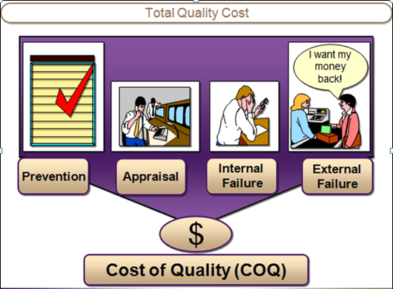
Cost of Quality

Slide 8
Components of Quality Cost
Prevention Cost:
The cost of activities specifically designed to prevent poor quality in products or services.
Training: Educating employees on how to do their jobs correctly.
Process Planning: Designing processes to minimize errors.
Quality Improvement Projects: Implementing methods like Six Sigma to improve quality.
Appraisal Cost:
The cost associated with measuring, evaluating or auditing products or services to
assure conformance to quality standards and performance requirements.
Testing: Checking products for defects.
Audits: Regular quality checks to ensure processes are being followed.
Inspections: Evaluating products at different stages of production.

Slide 9
Components of Quality Cost
Failure Cost:
The cost resulting from products or services not conforming
to requirements or customer/user needs i.e. the cost
resulting from poor quality.
Failure cost is divided into internal and external failure cost categories.
Cost Report

Slide 10
Components of Quality Cost (Cont..)
Internal Failure Cost:
Failure cost which occur prior to delivery or shipment of the product, or the furnishing of a service, to the customer.
External Failure Cost:
Failure cost which occur after shipment of the product or a service to the customer.

Slide 11
Components of Quality Cost (Cont..)
Prevention
Appraisal
Failure

Slide 12
Components of Quality Cost (Cont..)
Prevention Cost
Appraisal Cost
Quality Planning
Formal Technical Reviews
Staff Training
Requirement Analysis
Early Prototyping
Process Control
Consulting
Design Review
Code Inspection
Testing
Test Automation
Training Testers
Auditing
Monitoring

Slide 13
Components of Quality Cost (Cont..)
Internal Failure
External Failure
Bug Fixes
Regression Testing
Employee Turnover
Direct cost of late shipment
Wasted Advertisement
Rework
Scrap
Technical Support Calls
Penalties
Warranty Costs
Investigation of complaints
Lost of customer goodwill
Shipping of updated product
Cancelled licenses or orders

Slide 14
An extended model for cost of software quality
Managerial preparation and control costs
Costs of carrying out contract reviews (proposal draft and contract draft reviews).
Costs of preparing project plans, including quality plans and their review.
Costs of periodic updating of project and quality plans.
Costs of performing regular progress control of internal software development efforts.
Costs of performing regular progress control of external participants’ contributions to the project.

Slide 15
An extended model for cost of software quality
Managerial failure costs
Managerial failure costs can be incurred throughout the entire course of software development, beginning in the pre-project stage. Typical managerial failure costs include:
Unplanned costs for professional and other resources, resulting from underestimation of the resources upon which the submitted proposals are based.
Damages paid to customers as compensation for late completion of the project, a result of the unrealistic schedule presented in the company’s proposal.
Domino effect: damages to other projects performed by the same teams involved in the delayed projects. These damages should be considered managerial failure costs of the original project, whose scheduling problems interfered with the progress of other projects.

Slide 16
Numerical:
Calculating Total Cost of Quality
A company has the following cost components for a particular year:
Prevention Costs: $50,000
Appraisal Costs: $30,000
Internal Failure Costs: $20,000
External Failure Costs: $10,000
Question: Calculate the total cost of quality.
Solution: The Total Cost of Quality (COQ) is the sum of Prevention Costs, Appraisal Costs, Internal Failure Costs, and External Failure Costs.
Total COQ=Prevention Costs+ Appraisal Costs + Internal Failure Costs + External Failure Costs
The total cost of quality is $110,000

Slide 17
Numerical:
A company incurs the following costs:
Prevention Costs: $80,000 , Appraisal Costs: $40,000 , Internal Failure Costs: $25,000 , External Failure Costs: $35,000
Question: What proportion of the total cost of quality is due to failure costs?
Total COQ=80,000+40,000+25,000+35,000=180,000
Next, calculate the total failure costs.
Total Failure Costs = Internal Failure Costs + External Failure Costs=25,000+35,000=60,000
Now, calculate the proportion of failure costs.
Proportion of Failure Costs=(Total Failure Costs/Total COQ)×100
Proportion of Failure Costs=(60,000/180,000)×100=33.33%
Answer: The proportion of the total cost of quality due to failure costs is 33.33%.

Slide 18
Prevention Costs Example
Quality planning and design reviews | $5,000
Training for developers and testers | $3,000
Process improvement initiatives | $2,000
Total prevention costs | $10,000
Appraisal costs
Testing efforts (manual and automated) | $8,000
Code reviews and inspections | $2,500
Quality audits | $1,500
Total appraisal costs | $12,000
Failure costs
Costs of fixing defects during development | $6,000
Costs of fixing defects reported by customers after release | $15,000
Customer support for addressing issues | $3,000
Total failure costs | $24,000
Total Cost of Quality = Prevention Costs + Appraisal Costs + Failure Costs Total Cost of Quality = $10,000 + $12,000 + $24,000 = $46,000

Slide 19
1-10-100 Rule
Prevention
$
1
Correction
$
10
Failure
$
$
100
$

Slide 20
The 1-10-100 Rule
One dollar spent on prevention will save $10 on appraisal and $100 on failure costs.
This rule helps one to prioritize expenditure on prevention, which is sure to bring in greater returns.

Slide 21
The 1-10-100 Rule - Explanation
The earlier you detect and prevent a defect the more you can save. If you catch a two cent resistor before you use it and throw it away, you lose two cents.
If you don’t find it until it has been soldered into a computer component, it may cost $10 to repair the part. If you don’t catch the component until it is in the computer user’s hands, the repair will cost hundreds of dollars.
Indeed, if a $5000 computer has to be repaired in the field, the expense may exceed the manufacturing cost.

Slide 22
Quality costs increase over time
Liability costs
Failure found by customer
Field repair costs
Failure Costs
Failure found at installation
Failure found at final inspection
Failure found at onset of manufacture
Failure found during design phase
Prevention Costs
Time when failure found

Slide 23
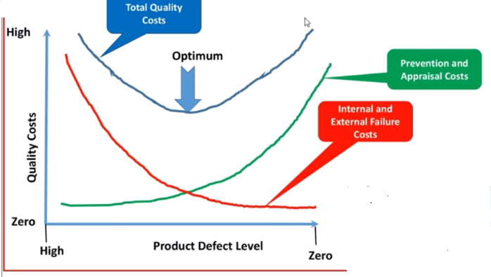
Relation between different quality cost

Slide 24
Hidden Costs of Poor Quality
Reprocessing
Customer returns
Rejects
Warranty expenses
Lost sales
Loss of goodwill
Overtime to correct errors
Process downtime
Extra inventory
Delays
Premium freight costs
Extra process capacity
Extra inventory

Slide 25
Numerical:
Particular | Amount
Sales | 1,000,000
Quality checks and inspection | 10,000
Raw materials appraisal cost | 30,000
Repairs on finished goods | 15,000
Warrant cost and product returns | 5,000
Total cost of good quality | ?
Total cost of poor quality | ?
Total cost of quality | ?

Slide 26
Numerical:
Problem: Identifying and Categorizing Quality Costs
A company reports the following costs:
$15,000 for training employees on quality standards.
$10,000 for inspection and testing of products before shipment.
$5,000 for rework of defective products found during production.
$7,000 for returns and warranty claims from customers.
Tasks:
Identify and categorize each cost as either Prevention Cost, Appraisal Cost, Internal Failure Cost, or External Failure Cost.
Calculate the total cost for each category.
Determine the total cost of quality.
Calculate the proportion of each type of cost with respect to the total cost of quality.

Slide 27
Answer:
Prevention Cost: $15,000 (40.54%)
Appraisal Cost: $10,000 (27.03%)
Internal Failure Cost: $5,000 (13.51%)
External Failure Cost: $7,000 (18.92%)
Total Cost of Quality: $37,000
Categorization:
Prevention Cost: $15,000 (Training employees on quality standards)
Appraisal Cost: $10,000 (Inspection and testing of products before shipment)
Internal Failure Cost: $5,000 (Rework of defective products found during production)
External Failure Cost: $7,000 (Returns and warranty claims from customers)
Total Cost for Each Category:
Total Prevention Costs: $15,000
Total Appraisal Costs: $10,000
Total Internal Failure Costs: $5,000
Total External Failure Costs: $7,000
Total Cost of Quality: 37,000
Proportion of each categories
Proportion of prevention cost: 15,000/37,000×100 ≈ 40.54
Proportion of Appraisal cost:
Proportion of Internal failure cost:
Proportion of External failure cost:

Slide 28
Any question????

